Slide 1
Consistency and Consensus in Distributed Systems
Insights from "Designing Data-Intensive Applications," Chapter 9
Notes:
Hello everyone, and welcome. Today, we're going to dive into a fundamental, and often tricky, part of distributed systems: consistency and consensus. This is Chapter 9 of 'Designing Data-Intensive Applications.'
If you've ever wondered how a distributed database or system ensures that all users see the same data, or how it handles failures without losing information, then you're in the right place. We'll be exploring the guarantees that systems can provide, the trade-offs they make, and the algorithms that make it all possible.
Our goal today is to demystify these concepts. We'll start with the basics of consistency models, from the eventual consistency you might have heard of, to the much stronger guarantee of linearizability. We'll then explore how ordering and causality play a crucial role in how distributed systems behave. Finally, we'll unravel the mystery of consensus—what it is, why it's so important, and how it's achieved.
By the end of this presentation, you'll have a solid understanding of these core principles, which will help you design and build more reliable and robust distributed systems. Let's get started.

Slide 2
Key Concepts (Part 1)
Eventual Consistency:
If you stop writing to the database, eventually all reads will return the same value.
Why it matters: It's a weak guarantee, but it allows for high availability and performance. It's the default for many distributed systems, but it can be tricky for developers.
Stronger Consistency Models:
Provide more intuitive guarantees for developers.
Examples: Linearizability, Causal Consistency.
Why it matters: Stronger models are easier to reason about and can prevent subtle bugs, but they often come with performance costs
Notes:
To begin, let's talk about the most basic consistency model: eventual consistency. At its core, eventual consistency is a simple promise: if you stop making changes to the data, all the replicas of that data will eventually converge to the same value.
Think of it like gossip spreading through a group of people. Eventually, everyone hears the same story, but in the meantime, different people might have different versions of it. This is why it's considered a weak guarantee—it doesn't say when the data will be consistent, just that it will be, eventually.
So why does it matter? Eventual consistency is the foundation for many highly available and performant systems. By not requiring immediate consistency across all replicas, systems can respond to requests faster and tolerate network partitions. However, for us as developers, it can be a double-edged sword. It's less intuitive than what we're used to in single-threaded programming, and it can lead to subtle bugs if we're not careful.
This brings us to stronger consistency models. These models aim to provide guarantees that are more like our single-threaded world. The most well-known of these is linearizability, which we'll discuss next, but there are others like causal consistency.
The key takeaway here is that stronger models are easier to work with. They can help us avoid a whole class of bugs related to data consistency. But as we'll see, these stronger guarantees don't come for free. They often involve trade-offs in performance and availability.

Slide 3
Key Concepts (Part 2)
Linearizability (or Strong Consistency):
The system appears as if there's only one copy of the data, and all operations are atomic.
Guarantees that a read will return the most recent, up-to-date value.
Why it matters: It's the most intuitive consistency model. It simplifies development by hiding the complexity of replication, making the system behave like a single-threaded program.
Consensus:
The process of getting all nodes in a distributed system to agree on something.
Why it matters: It's essential for solving critical problems like leader election and ensuring that all nodes have a consistent view of the system's state.
Notes:
Now let's zoom in on one of the most important strong consistency models: linearizability. You might also hear it called atomic consistency, strong consistency, or immediate consistency.
The core idea is to make a distributed system behave as if there's only a single copy of the data. When you write a value, any subsequent read from any client must see that new value. It's a recency guarantee—you're always getting the freshest data.
This is a powerful illusion. Even though the system has multiple replicas of the data, linearizability hides that complexity from you. It makes the database feel like a simple variable in your code. This is why it matters so much—it's the most intuitive model for developers. It eliminates a lot of the 'gotchas' that come with eventual consistency.
Next, we have consensus. In a distributed system, how do all the nodes agree on something? For example, in a database with a single leader, how do all the nodes agree on who the leader is, especially if the current leader fails? This is where consensus comes in.
Consensus is a fundamental problem in distributed systems. It's the process of getting a group of nodes to agree on a single value or decision. It's the bedrock for solving a lot of other problems, like leader election, atomic commits in distributed transactions, and ensuring that all nodes have a consistent understanding of the system's state. Without consensus, building truly fault-tolerant systems would be nearly impossible. We'll be talking a lot more about this later.

Slide 4
Deep-Dive: What Makes a System Linearizable?
The Illusion of a Single Copy:
Once a write is complete, all subsequent reads must see the new value.
If a read returns a new value, all subsequent reads must also return the new value.
Example: The World Cup Final
Alice sees the final score.
She tells Bob.
Bob refreshes and sees the game is still ongoing.
This is a violation of linearizability.
Notes:
So, what does it really mean for a system to be linearizable? Let's break it down.
The main idea is to create the illusion of a single copy of the data. This has a couple of important implications. First, once a client successfully writes a new value, any other client that reads that data must see the new value. No stale data is allowed.
But there's a more subtle point. If any client reads a new value, every subsequent read, no matter which client it's from, must also see that new value. The state of the data can only move forward in time.

Slide 5
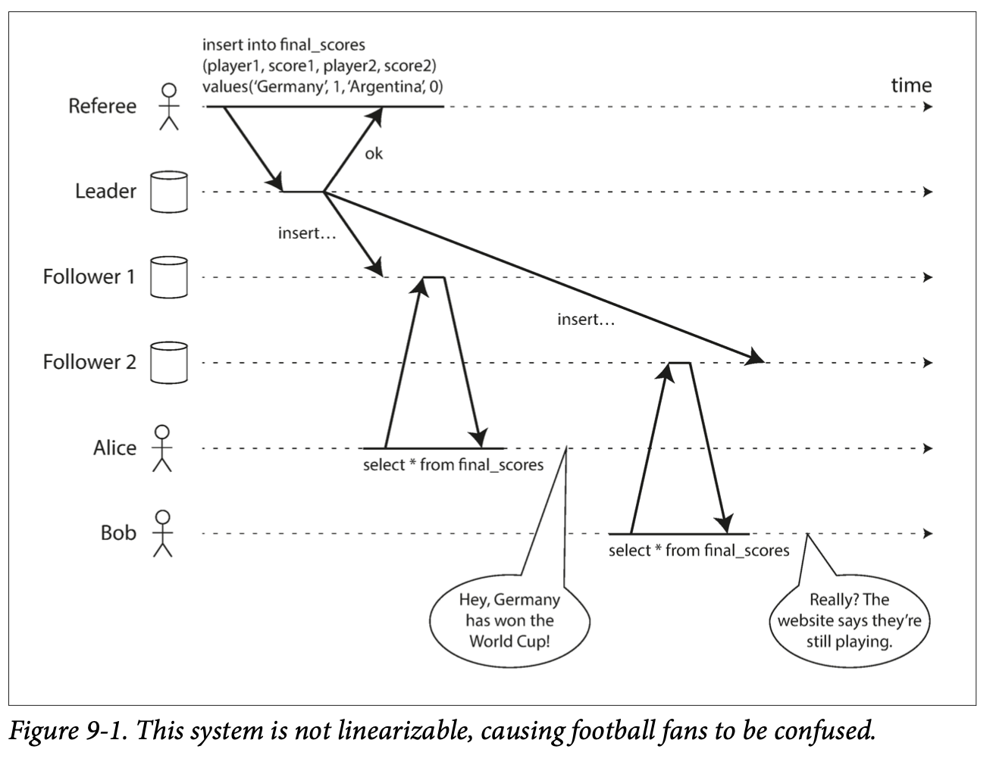
Deep-Dive: What Makes a System Linearizable?
Notes:
To make this more concrete, let's look at the example from the book, which I've included here as Figure 9-1. Alice and Bob are watching the World Cup final. The game ends, Alice refreshes her phone and sees that Germany has won. She excitedly tells Bob. Bob, a bit skeptical, immediately refreshes his own phone, but his request goes to a lagging replica, and it tells him the game is still in progress.
This is a classic example of a linearizability violation. From Bob's perspective, he knows he refreshed after Alice saw the final score. So, he expects to see a result that's at least as recent as what Alice saw. The fact that he got an older result is what breaks the illusion of a single copy of the data. In a linearizable system, this wouldn't happen.

Slide 6
Deep-Dive: Linearizability vs. Serializability
They are not the same!
Serializability:
An isolation property of transactions (groups of operations).
Guarantees that transactions behave as if they executed in some serial order.
Linearizability:
A recency guarantee for reads and writes of a single object.
It's about the real-time ordering of operations.
Strict Serializability:
The combination of serializability and linearizability.
Notes:
A common point of confusion is the difference between linearizability and serializability. The names sound similar, but they're two distinct concepts.
Serializability, which we discussed in the context of transactions, is an isolation property. It's about grouping multiple read and write operations together into a transaction. It guarantees that the outcome of running transactions concurrently is the same as if they had run one at a time, in some serial order. The key here is 'some' order—the database is free to reorder transactions for performance, as long as the outcome is the same.
Linearizability, on the other hand, is a recency guarantee on individual operations, not transactions. It's about making sure that reads and writes to a single object appear to happen in a specific, real-time order. It's not about grouping operations.
So, you can have serializability without linearizability. For example, a database using snapshot isolation can be serializable, but its reads are from a slightly old snapshot of the data, so they're not linearizable.
When you combine both guarantees, you get what's called 'strict serializability' or 'strong one-copy serializability'. This is the strongest guarantee, where transactions appear to execute in a serial order, and that order matches the real-time order in which they happened. Systems using two-phase locking or actual serial execution are typically strictly serializable

Slide 7
Deep-Dive: The Cost of Linearizability & The CAP Theorem
Linearizability is expensive.
It requires coordination between replicas, which adds latency.
The CAP Theorem:
In the event of a network partition, a system must choose between:
Consistency (Linearizability): Wait for the partition to heal, becoming unavailable.
Availability: Continue operating, but sacrifice linearizability.
Often misunderstood: It's not "pick two of three." It's a choice you have to make when a partition happens.
Notes:
So, if linearizability is so great, why doesn't every system use it? The simple answer is: it's slow.
To guarantee that every read gets the absolute latest value, a system needs to coordinate between its replicas. This coordination takes time and adds latency to every operation. This is true all the time, not just when there are network problems.
This brings us to the famous CAP theorem. You've probably heard it as 'Consistency, Availability, Partition Tolerance: pick two out of three.' But that's a bit misleading.
A more accurate way to think about it is this: a network partition is a type of fault. It's not something you can choose to have or not have. It's going to happen. When it does, you're forced to make a choice.

Slide 8
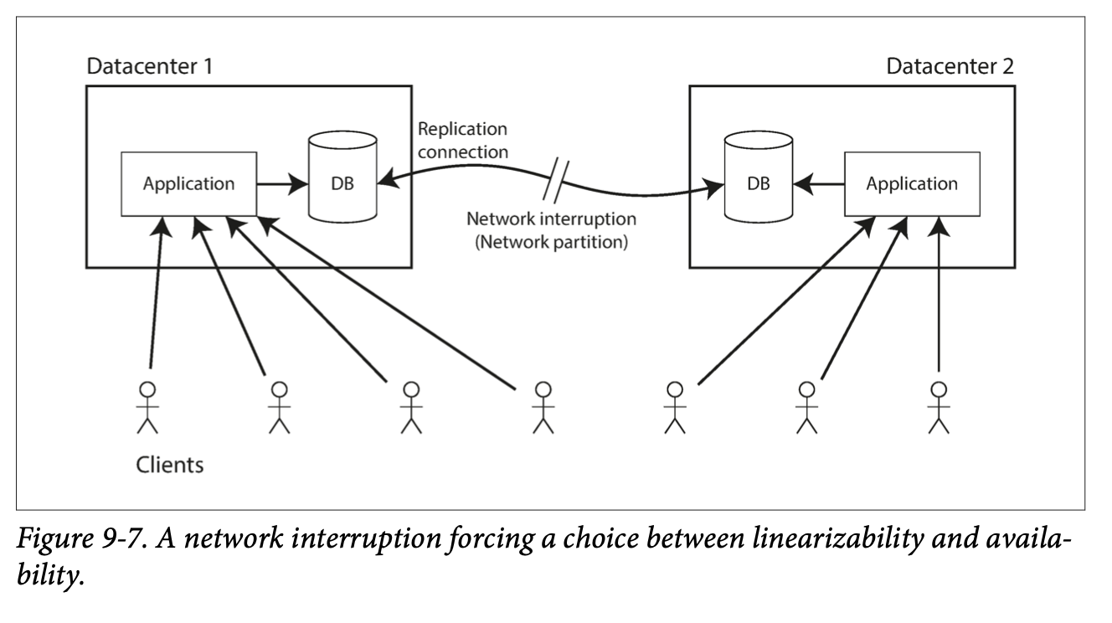
Deep-Dive: The Cost of Linearizability & The CAP Theorem
Notes:
Let's look at Figure 9-7. We have two datacenters, and the network link between them is broken. If our system requires linearizability (the 'C' in CAP), then one of the datacenters, the one without the leader, can't safely process writes. It has to wait for the network to be repaired, so it becomes unavailable.
On the other hand, if we prioritize availability (the 'A' in CAP), we can let both datacenters continue to accept writes. The system stays available, but now their data is diverging. They are no longer linearizable.
So, the CAP theorem is really about a trade-off you have to make during a network failure. Do you want to stay correct (linearizable) but risk being unavailable, or stay available but risk being inconsistent?

Slide 9
Deep-Dive: Ordering and Causality
Causality: The principle that a cause must come before its effect.
A question is asked before it's answered.
A row is created before it's updated.
Causal Consistency:
A consistency model that respects causality.
If you see an effect, you must also see its cause.
It's a partial order: some operations are ordered, others are concurrent.
Linearizability implies Causality:
Linearizability is a total order, which is stronger than the partial order of causality.
Notes:
Let's shift gears a bit and talk about ordering. Ordering is a fundamental concept that keeps popping up in distributed systems, and a key reason for that is causality.
Causality is just like it sounds in real life: a cause comes before its effect. You ask a question before you get an answer. You create a user account before you can log in. This 'happens-before' relationship creates a causal dependency.
A system that respects these dependencies is called causally consistent. If you read some data from a causally consistent database, and that data is the answer to a question, you're guaranteed to also see the question itself.
You can think of causality as defining a partial order. Some operations are causally related—one happens before the other. But other operations might be concurrent, meaning there's no causal relationship between them. They are incomparable.
So, how does this relate to linearizability? Linearizability is stronger than causal consistency. A linearizable system puts all operations into a single, total order—a straight timeline with no branches. This total order will always be consistent with causality.
The takeaway here is that linearizability is not the only way to preserve causality. Causal consistency is a weaker, but still very useful, guarantee that can be implemented more efficiently.

Slide 10
Deep-Dive: Lamport Timestamps
A way to generate sequence numbers that are consistent with causality.
How it works:
Each node has a unique ID and a counter.
A timestamp is a pair: (counter, node ID).
Every time a node sends or receives a message, it updates its counter to be greater than the maximum counter value it has seen.
This creates a total order of operations that respects causality.
Notes:
So, if we want to build a causally consistent system, how do we keep track of the causal order? One of the most elegant solutions is the Lamport timestamp, invented by Leslie Lamport in 1978.
A Lamport timestamp is not a real-time clock. It's a logical clock, designed to create a total ordering of events that's consistent with causality.

Slide 11
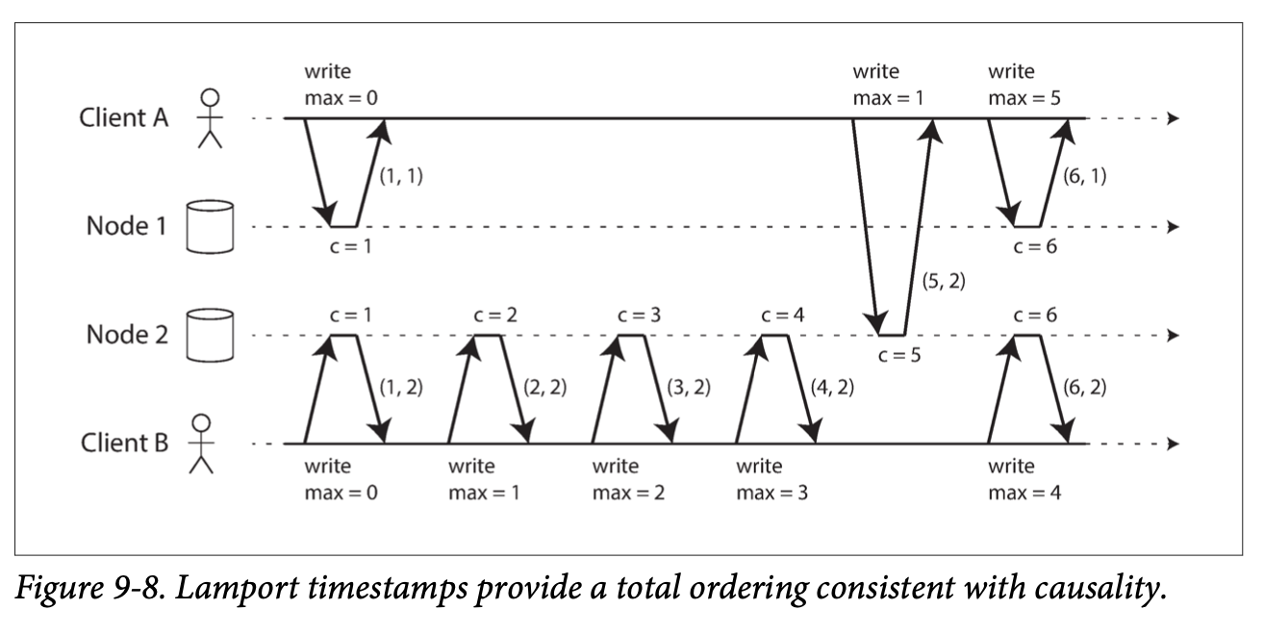
Deep-Dive: Lamport Timestamps
Notes:
Here's how it works, and you can follow along with Figure 9-8. Each node in the system has a unique ID and a counter. The timestamp for an operation is a pair: the current value of the counter, and the node's ID.
The magic happens in how the counter is updated. Whenever a node sends or receives a message, it looks at the timestamp in the message. It then updates its own counter to be one greater than the maximum of its current counter and the counter from the message.
As you can see in the diagram, when Client A receives a response from Node 2 with a counter of 5, it then includes that maximum value in its next request to Node 1. Node 1's counter was only 1, but it immediately jumps to 5, and its next operation gets a timestamp with a counter of 6.
This simple mechanism ensures that if event A happens before event B, the Lamport timestamp of A will be less than the Lamport timestamp of B. It's a clever way to capture the causal flow of a system.

Slide 12
Deep-Dive: Total Order Broadcast
Also known as Atomic Broadcast.
A protocol for exchanging messages between nodes with two guarantees:
Reliable delivery: No messages are lost.
Totally ordered delivery: All nodes receive messages in the exact same order.
This is like creating a log that all nodes agree on.
It's the foundation for state machine replication.
Notes:
Now we come to a concept that ties a lot of these ideas together: total order broadcast, also known as atomic broadcast.
This is a protocol for sending messages between nodes in a distributed system, and it comes with two very strong guarantees. First, reliable delivery: if one node receives a message, all nodes will eventually receive it. No messages are lost.
Second, and most importantly, totally ordered delivery: all nodes receive the messages in the exact same order.
Think of it as creating a distributed log file. Every node can append messages to this log, and they all see the same sequence of messages. This is an incredibly powerful abstraction.
This is the basis for what's known as state machine replication. If you have a system where all changes are driven by a sequence of operations, and you can deliver those operations to all replicas in the same order using total order broadcast, then all the replicas will remain in a consistent state. It's how you can replicate a database and ensure all copies of the data stay in sync

Slide 13
Deep-Dive: Implementing Linearizability with Total Order Broadcast
Total order broadcast can be used to build linearizable storage.
Example: Unique Username Registration
Append a message to the log, claiming a username.
Read the log and wait for your message to be delivered back.
Check if your message is the first one for that username.
If yes, you win! The registration is successful.
If no, another user claimed it first. You abort.
All nodes agree on who came first because they see the same log order.
Notes:
We've seen that total order broadcast is powerful, but how does it connect back to linearizability? Well, you can use total order broadcast to build a linearizable system.
Let's take the example of ensuring that usernames are unique. This is a classic problem that seems to require linearizability. How can we do it with total order broadcast?
Here's the recipe. When a user tries to register a username, you don't write it directly to the database. Instead, you append a message to your distributed log, saying 'I want to claim the username "superstar". Then, you read the log and wait for your own message to be delivered back to you. Because of the total ordering guarantee, all nodes will see all the registration attempts in the same order.
When your message comes back, you check the log. Was your message the first one for the username 'superstar'? If so, congratulations, you got it! You can commit the registration. If another user's message for the same username appears earlier in the log, then they beat you to it, and you have to abort your registration.
Because all nodes see the same log, they will all agree on who the winner is. This is how you can implement a linearizable compare-and-set operation, which is the building block for many other linearizable operations.

Slide 14
Deep-Dive: Total Order Broadcast and Consensus
Total order broadcast is equivalent to consensus.
If you can solve one, you can solve the other.
How they relate:
You can think of total order broadcast as repeated rounds of consensus.
In each round, the nodes run a consensus algorithm to agree on the next message to be added to the log.
This equivalence is a profound insight in distributed systems.
Notes:
By now, you might be sensing a deep connection between total order broadcast and consensus. And you'd be right. It turns out that total order broadcast and consensus are, for all practical purposes, equivalent problems.
If you have an algorithm that solves total order broadcast, you can use it to solve consensus. And if you have an algorithm for consensus, you can use it to build total order broadcast.
How? You can think of total order broadcast as a series of consensus decisions. For each message that needs to be delivered, the nodes in the system run a round of consensus to agree on what that message will be.
The agreement property of consensus ensures that all nodes deliver the same messages in the same order. The validity property ensures that no messages are made up out of thin air. And the termination property ensures that messages are eventually delivered.
This equivalence is one of the most important and profound results in the theory of distributed systems. It tells us that these two seemingly different problems are actually two sides of the same coin.

Slide 15
Deep-Dive: Distributed Transactions and Two-Phase Commit (2PC)
Atomic Commit: Ensuring that a transaction across multiple nodes either commits everywhere or aborts everywhere.
Two-Phase Commit (2PC): A classic algorithm for atomic commit.
Phase 1 (Prepare): A coordinator asks all participants if they are ready to commit. Participants promise to commit if asked.
Phase 2 (Commit): If all participants say "yes," the coordinator tells them to commit. Otherwise, it tells them to abort.
Notes:
Let's now turn our attention to distributed transactions. When a transaction involves changes to data on multiple machines, how do we ensure atomicity? How do we make sure that it either commits on all nodes, or aborts on all nodes? This is the atomic commit problem.
The most common algorithm for this is two-phase commit, or 2PC. As the name suggests, it has two phases.

Slide 16
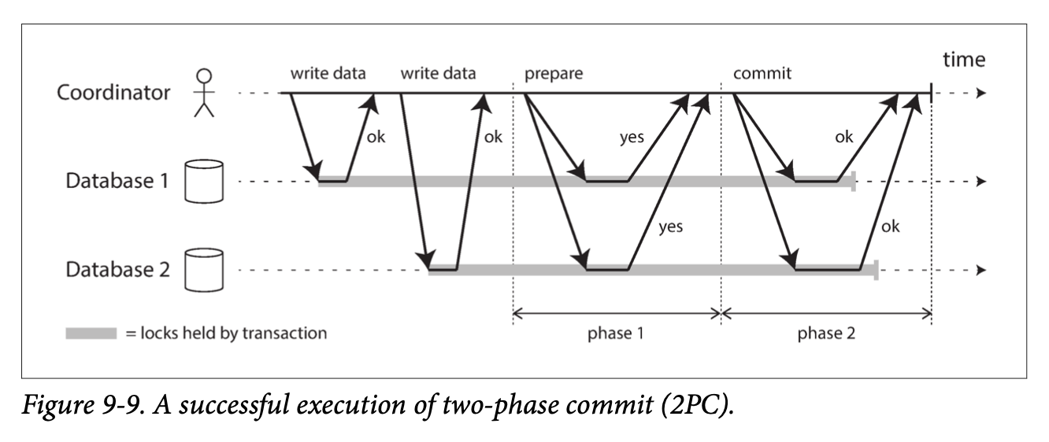
Deep-Dive: Distributed Transactions and Two-Phase Commit (2PC)
Notes:
Let's walk through Figure 9-9. The system has a coordinator, which manages the transaction. In Phase 1, the coordinator sends a 'prepare' request to all the participating nodes. This is like asking, 'Are you ready to commit?'
When a participant receives this request, it checks if it can commit the transaction. If it can, it writes all the changes to disk, and then replies 'yes' to the coordinator. This 'yes' is a promise. It's a binding agreement. The participant is now giving up its right to abort the transaction.
In Phase 2, the coordinator collects all the responses. If everyone said 'yes', it makes the decision to commit. It writes this decision to its own log, and then sends a 'commit' message to all participants. If even one participant said 'no', or failed to respond, the coordinator decides to abort and sends 'abort' messages to everyone.
This two-phase process, with its system of promises, is what ensures atomicity.

Slide 17
Deep-Dive: Problems with 2PC: Coordinator Failure
What if the coordinator crashes?
If a participant has voted "yes" but hasn't received the final commit/abort decision, it becomes "in-doubt".
The participant is blocked:
It cannot unilaterally commit or abort.
It must hold onto locks on the data, blocking other transactions.
Recovery depends on the coordinator's log. If that log is lost, the system is stuck.
Notes:
Two-phase commit sounds solid, but it has a significant Achilles' heel: what happens if the coordinator fails? This is where the problems begin.

Slide 18
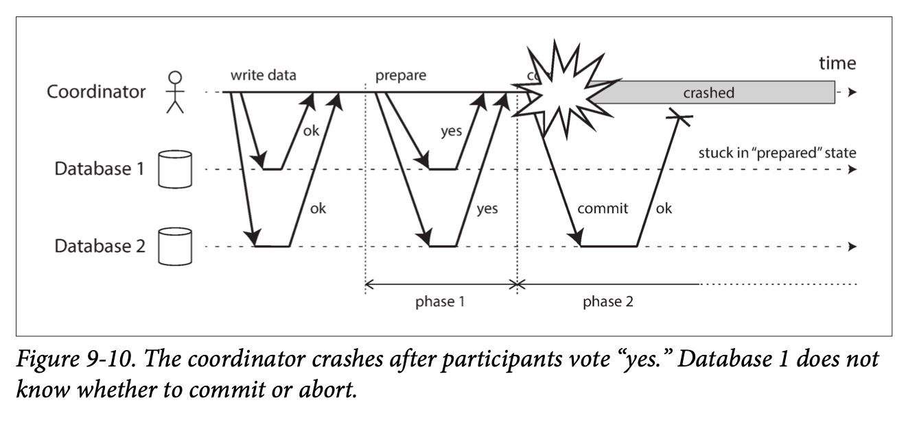
Deep-Dive: Problems with 2PC: Coordinator Failure
Notes:
Look at Figure 9-10. The coordinator has received 'yes' votes from both participants. It has decided to commit, and has even sent the commit message to Database 2. But before it can send the message to Database 1, it crashes.
Now, Database 1 is in a state of limbo. It has promised to commit, but it doesn't know the final outcome of the transaction. This is called an 'in-doubt' or 'uncertain' state.
And here's the critical problem: Database 1 is now blocked. It can't unilaterally decide to commit, because the transaction might have been aborted. And it can't decide to abort, because it might have been committed elsewhere.
What's worse, while it's in this in-doubt state, it has to hold on to all the locks for the transaction's data. This means other transactions that need to access that data are also blocked. A single coordinator failure can cause a cascading wave of unavailability across the system.
The only way out is for the coordinator to recover. It has to read its transaction log to find out the decision for the in-doubt transaction, and then resume sending the commit messages. If the coordinator's log is lost, you're in serious trouble.

Slide 19
Deep-Dive: Fault-Tolerant Consensus
2PC is a form of consensus, but not a fault-tolerant one.
It violates the "termination" property: it can get stuck forever.
Fault-Tolerant Consensus Algorithms:
Examples: Paxos, Raft, Zab.
They guarantee progress as long as a majority of nodes are running.
How they work (high-level):
They elect a leader.
The leader proposes values.
A proposal is accepted only if it's approved by a quorum (a majority) of nodes.
This prevents split-brain and ensures safety.
Notes:
The problems with 2PC lead us to a better solution: fault-tolerant consensus.
Two-phase commit is, in fact, a type of consensus algorithm. But it's not a very good one, because it's not fault-tolerant. It violates a key property of consensus called 'termination', which says that the system must eventually make a decision. As we saw, 2PC can get stuck if the coordinator fails.
This is where fault-tolerant consensus algorithms like Paxos, Raft, and Zab come in. These are the algorithms that power systems like ZooKeeper, etcd, and many modern distributed databases.
At a high level, they all work in a similar way. They use a leader, much like in single-leader replication. But the leader is elected by the nodes themselves, and it can only make decisions with the support of a quorum, which is typically a majority of the nodes.
So, for a leader to get a proposal accepted, it has to send it to the other nodes and get a 'yes' vote from a majority. This majority quorum mechanism is what prevents split-brain scenarios and ensures that even if some nodes fail, the system as a whole can continue to make progress. It's what makes these algorithms truly fault-tolerant

Slide 20
Deep-Dive: Membership and Coordination Services (ZooKeeper)
Services like ZooKeeper and etcd provide "consensus-as-a-service".
They offer a set of useful primitives for building distributed systems:
Linearizable atomic operations: For distributed locks.
Total ordering of operations: For fencing tokens.
Failure detection: Through sessions and heartbeats.
Change notifications: To watch for changes in data.
They are used for:
Leader election
Service discovery
Managing cluster membership
Notes:
So, are you expected to go out and implement Paxos or Raft yourself? Thankfully, no. This is where services like Apache ZooKeeper and etcd come in.
You can think of them as providing 'consensus-as-a-service'. They are specialized, small-scale databases that are designed to do one thing really well: run a fault-tolerant consensus algorithm.
They expose a simple key-value store API, but under the hood, all writes go through a consensus protocol. This allows them to provide a powerful set of primitives for building distributed systems.
They give you linearizable atomic operations, which are perfect for implementing distributed locks. They provide a total ordering of all operations, which gives you a natural way to generate fencing tokens. They have built-in failure detection using sessions and heartbeats. And you can subscribe to notifications to be alerted when data changes.
So, what do you use them for? The classic use cases are leader election, service discovery, and managing the membership of a cluster. They essentially outsource the hardest parts of distributed coordination to a reliable, external service.

Slide 21
Summary & Takeaways
Consistency is a spectrum: From weak (eventual) to strong (linearizable).
Linearizability is intuitive but costly. The CAP theorem highlights the trade-off between linearizability and availability during network partitions.
Causality is a fundamental ordering principle. Causal consistency is a powerful model that's more performant than linearizability.
Total Order Broadcast is equivalent to Consensus. It's a powerful abstraction for building replicated systems.
Two-Phase Commit enables distributed transactions but has significant operational drawbacks.
Fault-Tolerant Consensus (e.g., Raft, Paxos) is the key to building truly reliable distributed systems. Services like ZooKeeper make this accessible
Notes:
Alright, let's wrap up and review what we've learned.
First, consistency isn't a single thing; it's a spectrum. On one end, we have weak guarantees like eventual consistency, which are great for performance and availability. On the other end, we have strong guarantees like linearizability, which are much more intuitive for developers.
We saw that linearizability comes at a cost, both in performance and, as the CAP theorem shows, in availability during network failures.
We then explored causality as a fundamental ordering principle in distributed systems. Causal consistency is a 'goldilocks' model—it's strong enough to prevent many confusing behaviors, but not so strong that it incurs the high costs of linearizability.
We learned that total order broadcast, the idea of delivering messages to all nodes in the same order, is equivalent to the problem of consensus. This is a powerful tool for building replicated, consistent systems.
We looked at two-phase commit, the classic algorithm for distributed transactions. While it solves the problem of atomic commit, its reliance on a central coordinator makes it a fragile, blocking protocol with significant operational challenges.
Finally, we saw that fault-tolerant consensus algorithms like Raft and Paxos are the state-of-the-art solution for achieving agreement in a distributed system. And thankfully, we don't have to implement them ourselves. We can rely on services like ZooKeeper to handle this for us.
Understanding these concepts is crucial for anyone building or working with distributed systems. They help us reason about the guarantees our systems provide, the trade-offs they make, and how to build them to be resilient in the face of failure.

Slide 22
Live Discussion
1. For a new project, what types of features or business requirements would immediately make you choose a system with strong linearizability, despite the performance costs we discussed? Conversely, for what kinds of applications would you be comfortable managing the developer complexity that comes with eventual consistency?
2. We've discussed failure modes like "in-doubt" transactions in 2PC that can block the system or frequent leader elections slowing things down. Can anyone share an experience where a system's consistency model—or lack thereof—caused a surprising bug or a difficult production outage? What was the root cause, and how did it change how you think about these trade-offs?
Notes:
That brings us to the end of this overview of 'Consistency and Consensus in Distributed Systems
We've covered a lot of challenging ground. Hopefully, this gives you a better appreciation for the complexities involved and some of the core problems that distributed systems engineers grapple with every day.
Let's open the group up for discussion with these questions. [read question one and then ask the group, encourage participation then move on to number 2]

